Slide 1
Chapter 10
INDEPENDENT-SAMPLES T TEST

Slide 2
Independent-Samples t Test
Compares two means for a between-groups design
Between-groups design?
  each participant is assigned to only one level of the IV

Slide 3
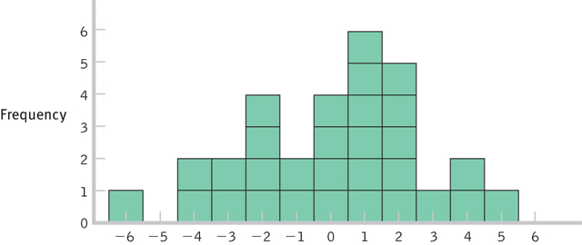
Modified Sampling Distribution
Independent-samples t test relies on a sampling distribution of differences between means

Slide 4
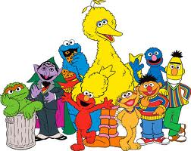
Example
Is watching Sesame Street as a 5-year-old related to an individual’s performance in high school?

Slide 5
Data
Average grade of 10 high school students who regularly watched Sesame Street
  86, 87, 91, 97, 98, 99, 97, 94, 89, 92
Average grade of 9 high school students who did not watch Sesame Street
  90, 89, 82, 83, 85, 79, 83, 86, 81

Slide 6
Step 1: Identify
Populations
  High school students who did not watch Sesame Street
  High school students who regularly watched Sesame Street
Comparison distribution
  distribution of differences between means
Hypothesis test
  independent-samples t test
Assumptions
  DV is scale
  Convenience sample
  N = 19

Slide 7
Step 2: H₀ & H₁
H₀ : No difference between populations
  H₀ : μ₁ = μ₂
H₁ : There is a difference between populations
  H₁ : μ₁ ≠ μ₂

Slide 8
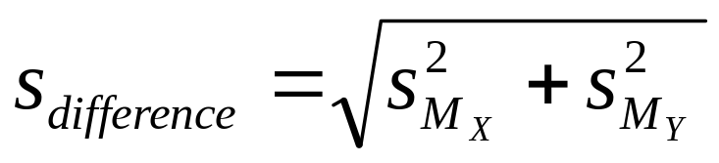
Step 3: Identify the Sampling Distribution
μ_{M} = 0

Slide 9
Calculating the Standard Error
Step 1. Calculate the corrected variance for each sample
X | X-M | (X-M)²
86 | -7 | 49
87 | -6 | 36
91 | -2 | 4
97 | 4 | 16
98 | 5 | 25
99 | 6 | 36
97 | 4 | 16
94 | 1 | 1
89 | -4 | 16
92 | -1 | 1
High school students
who regularly
watched
Sesame Street (X)
M = 93
SS = 200

Slide 10
Calculating the Standard Error
Step 1. Calculate the corrected variance for each sample
Y | Y-M | (Y-M)²
90 | 5.8 | 33.64
89 | 4.8 | 23.04
82 | -2.2 | 4.84
83 | -1.2 | 1.44
85 | 0.8 | 0.64
79 | -5.2 | 27.04
83 | -1.2 | 1.44
86 | 1.8 | 3.24
81 | -3.2 | 10.24
High school students
who did not watch
Sesame Street (Y)
M = 84.2
SS = 105.56

Slide 11
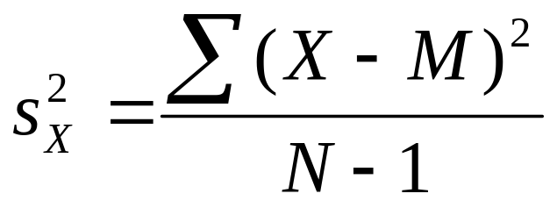
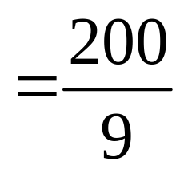

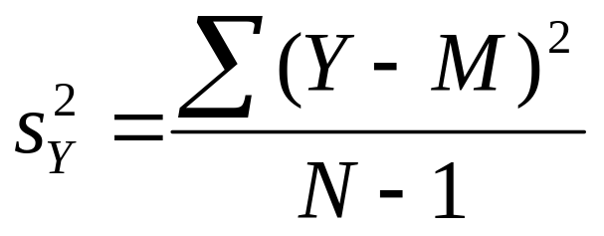
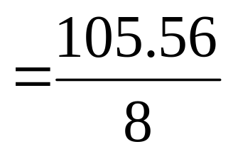

Calculating the Standard Error

Slide 12
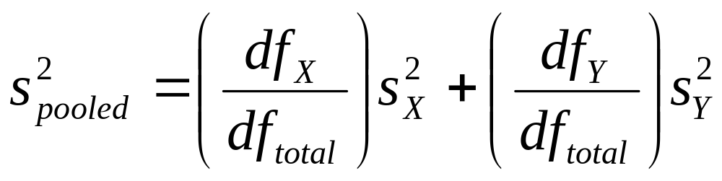
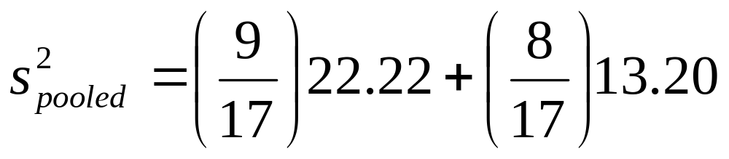
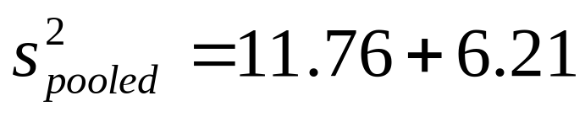
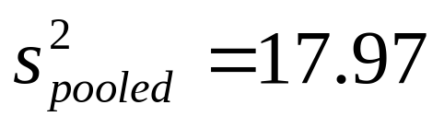
Calculating the Standard Error
Step 2. Pool the variances.

Slide 13
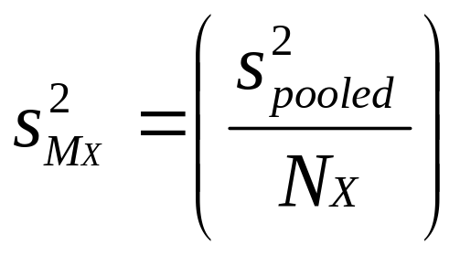
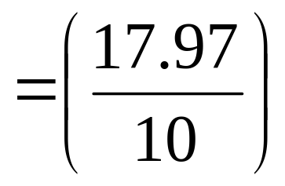

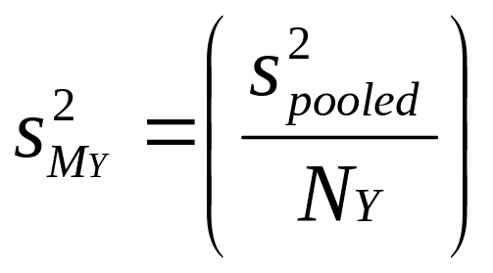
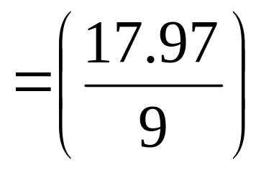

Calculating the Standard Error
Step 3. Convert pooled variance to squared standard error

Slide 14
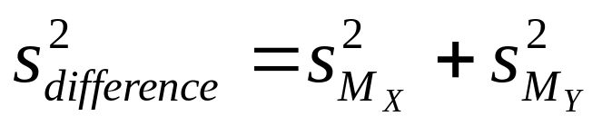
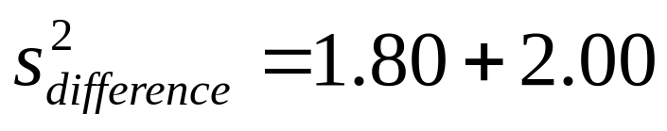
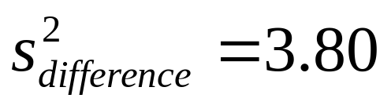
Calculating the Standard Error
Step 4. Add the two variances

Slide 15
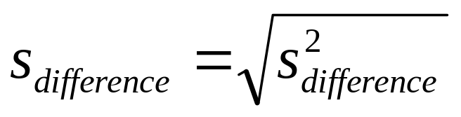
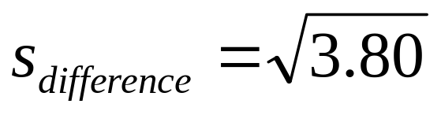
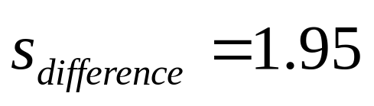
Calculating the Standard Error
Step 5. Calculate the square root – this will give you the estimated standard error of the distribution of mean differences

Slide 16

Step 3: Identify the Sampling Distribution
μ_{M} = 0

Slide 17
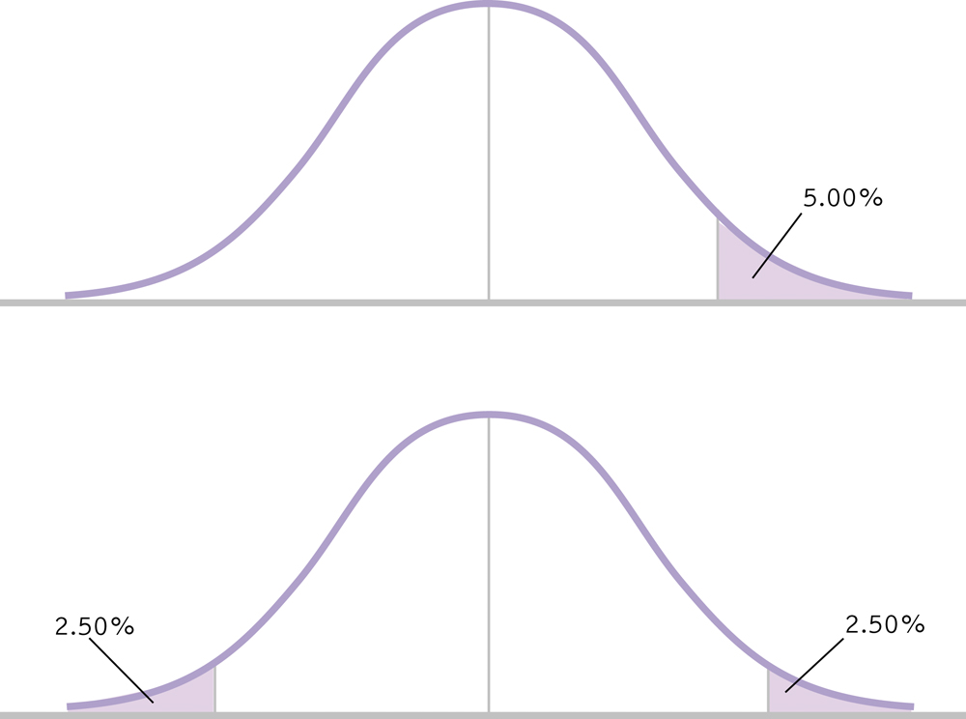
Step 4: Determine Critical Values
Two-tailed, α = .05
df_{total} = 17
-2.110
2.110

Slide 18
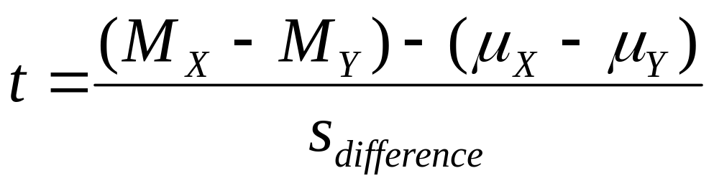
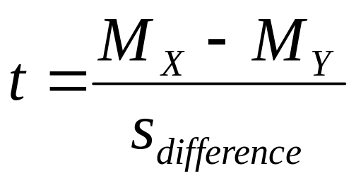
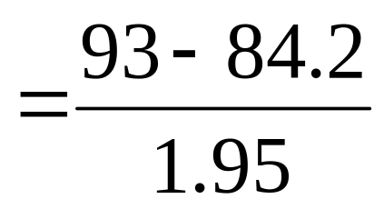
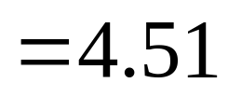
Step 5: Calculate t

Slide 19
Step 6: Make a Decision
Is the calculated t in the rejection region?
4.51
-2.110
2.110

Slide 20
Step 6: Make a Decision
Reject H₀
The students who watched Sesame Street had significantly higher grades than those who did not watch the program, t(17)=4.51, p<.05.
  M_{X} = 93
  M_{Y} = 84.2

Slide 21
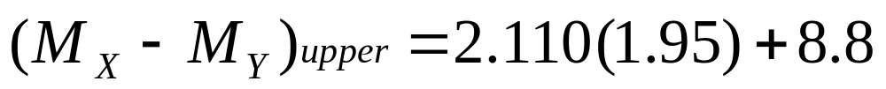
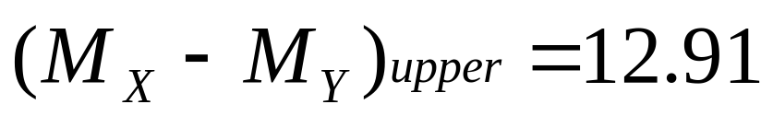
Confidence Interval: Upper Limit

Slide 22
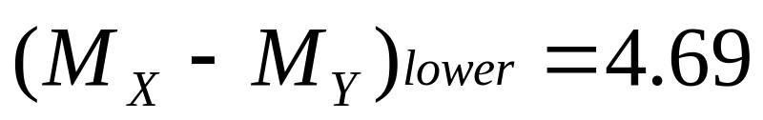
Confidence Interval: Lower Limit

Slide 23
Confidence Interval
95% confidence interval is [4.69, 12.91]
This interval would contain the population mean difference 95% of the time
Those who watch Sesame Street have a population mean somewhere between 4.69 and 12.91 higher than those who do not watch Sesame Street

Slide 24
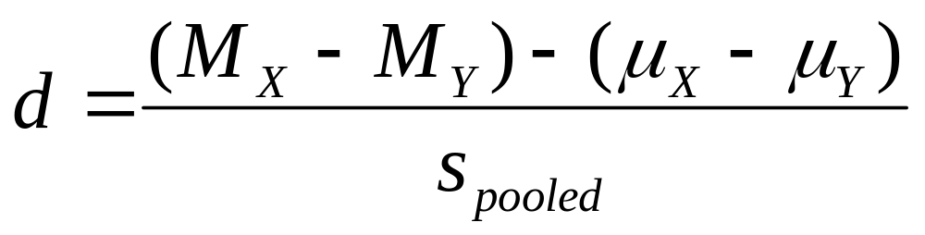
Effect Size

Slide 25
Calculating the Standard Error
Step 2. Pool the variances.

Slide 26
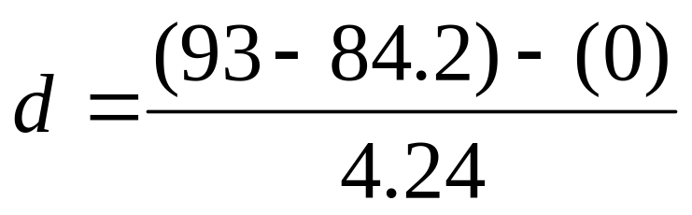
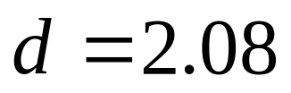
Effect Size
; large

